Slide 1
Presentation title here
Additional title slide text here

Slide 2



Our achievements
TOP 2% OF UNIVERSITIES IN THE WORLD
283rd in the world - QS World University Rankings 2014/2015
282nd in the world - Times Higher Education World University Rankings 2014/2015
329th in the world - Academic Ranking of World Universities (ARWU) 2014
314th in the world for research quality - 2014 Leiden Ranking
348th in the world – U.S. News Best Global Universities Ranking 2014
ONE OF AUSTRALIA’S BEST MODERN UNIVERSITIES
26th in the world - QS Top 50 Under 50 Rankings 2014
31st in the world - Times Higher Education Top 100 Under 50 Rankings 2015
GLOBALLY RATED A FIVE-STAR UNIVERSITY
QS World University Rankings 2014
Australian Good Universities Guide 2014

Slide 3
At a glance
31,464
total student enrolment
12,811
international students
143
nationalities at UOW
112,739
UOW Alumni
471
degrees on offer
95.1%
of students that indicated they would recommend UOW

Slide 4
Our research
TOP 1%
Research Quality 2013
2nd
ARC $ Relative to Size
1520
HDR Students 2013
9
Key Research Strengths
$55^{M}
Research Income 2013
5
Major Research Facilities

Slide 5
Our City
22°C
average daily temperature (71.6°F)
27°C
Average summer temperature (80.6°F)
292,500
Population of Illawarra
85km
to Sydney Opera House (53 miles)
17
patrolled surf beaches
11
National parks within 50km

Slide 6
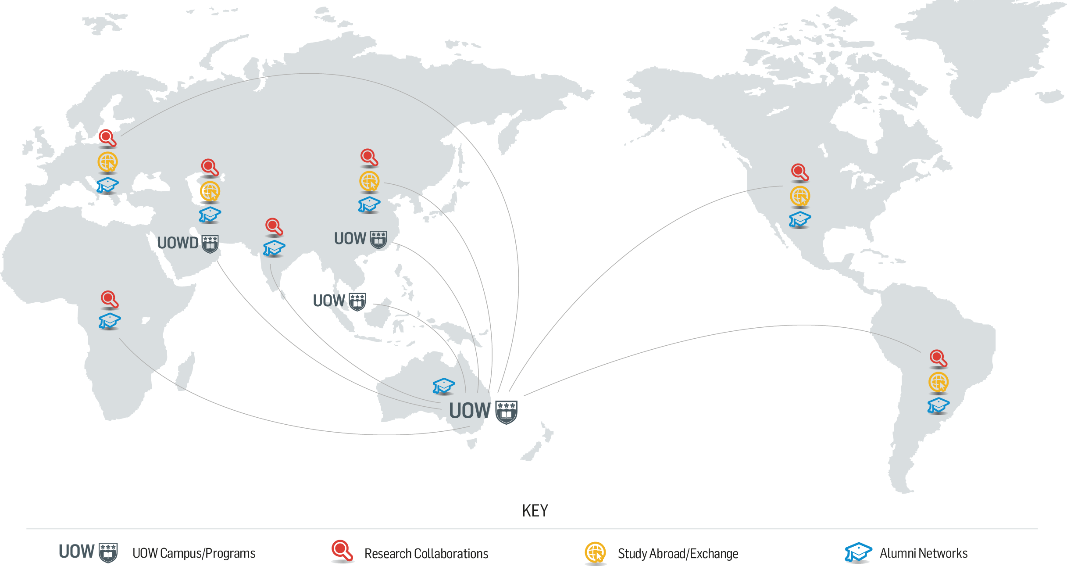
Our global presence

